Slide 1
­­ Little Lives, Big Data: Predicting Under-5 Mortality Danger Zones.

Slide 2
Title: Group Members
“Children who get a healthy start in life are more
likely to reach their full potential, with benefits for
themselves, their families and society as a whole.”
BERYL SAOKE (CHAIR)
AMADI GROWMAN
CAROLINE NGABU
GIDEON BIWOTT
MERCY CHEROTICH
SAMMY MACHARIA
State of the World’s Mothers
Save the Children, 2007
Organization: MORINGA SCHOOL
COURSE: DSF-PT05
Date: [Presentation Date]

Slide 3
02
01
INTRODUCTION
CONTENTS
02
BUSINESS UNDERSTANDING
03
OBJECTIVES
04
METHODOLOGY
05
DATA OVERVIEW
06
DATA ANALYSIS

Slide 4
07
VISUALIZATIONS
08
MODEL RESULTS
CONTENTS
09
INSIGHTS AND RECOMMENDATIONS
10
CONCLUSION
11
NEXT STEPS
12
Q&A

Slide 5
INTRODUCTION
Despite significant reduction in the Under-5 Mortality since 2000, it remains a major concern, particularly in low-income countries.
This project Identify high-risk categories for under-5 mortality based on causes of death and age.
Classifying high-risk groups can prioritize interventions and resource allocation for maximum impact

Slide 6
BUSINESS UNDERSTANDING
Under-5 mortality is a persistent global health challenge, highlighting healthcare system weaknesses and disparities in essential service access.
Although rates have halved since 2000, the burden remains high, especially in low- and middle-income countries.
Millions of under-5 deaths occur annually due to preventable causes such as infectious diseases and malnutrition.

Slide 7
OBJECTIVES
Main
The main goal of this analysis is to contribute to the reduction of child mortality rates by identifying high-risk populations, classifying mortality risk levels, and analyzing temporal trends.
Specific
Use unsupervised learning to identify populations at high risk of child mortality based on demographic and health-related factors.
Utilize Supervised learning to classify mortality risk levels for children based on cause-specific data
Use Time Series modeling to analyze temporal trends in child mortality rates and forecast future mortality rates.

Slide 8
METHODOLOGY
Explanation
Data Collection
Gather diverse datasets related to child mortality, including causes of death, demographic factors, and socioeconomic indicators from sources like Kaggle and web-scraped data.
Data Preprocessing
Using Python libraries like pandas, NumPy, and scikit-learn to ensure data quality, address missing values, inconsistencies, and data type validation.
EDA
Analyzing patterns and trends in under-5 mortality rates, cause-specific mortality data, economic indicators, and demographic factors.
Modeling Techniques
Employing unsupervised, supervised and Time series modeling for identifying high-risk populations, classifying mortality risk levels, and forecasting future mortality rates.
Model Evaluation
Using metrics such as accuracy, precision, recall, F1-score for classification models, and MSE for time series forecasting.
Impact
Providing actionable insights for stakeholders, policymakers, and healthcare professionals to contribute to global efforts in reducing under-5 mortality rates.

Slide 9
DATA OVERVIEW
We gathered extensive datasets on child mortality, incorporating causes of death, demographic details, and socioeconomic indicators. The six datasets were, drawn from Kaggle, WHO UNICEF and world bank.
Feature Relevance
Cause-specific mortality data, GDP, and child mortality rates by age and sex are crucial for understanding under-5 mortality trends.
Problem Relevance
The dataset aligns with the project's goal of analyzing under-5 mortality rates and identifying high-risk areas for interventions.
Duration Coverage
Covers 1990 to 2019, offering historical data for trend analysis and effectiveness assessment of past interventions.
Analytical Opportunities
Enables techniques like time series and spatial analysis to uncover patterns and forecast mortality trends for targeted interventions.

Slide 10
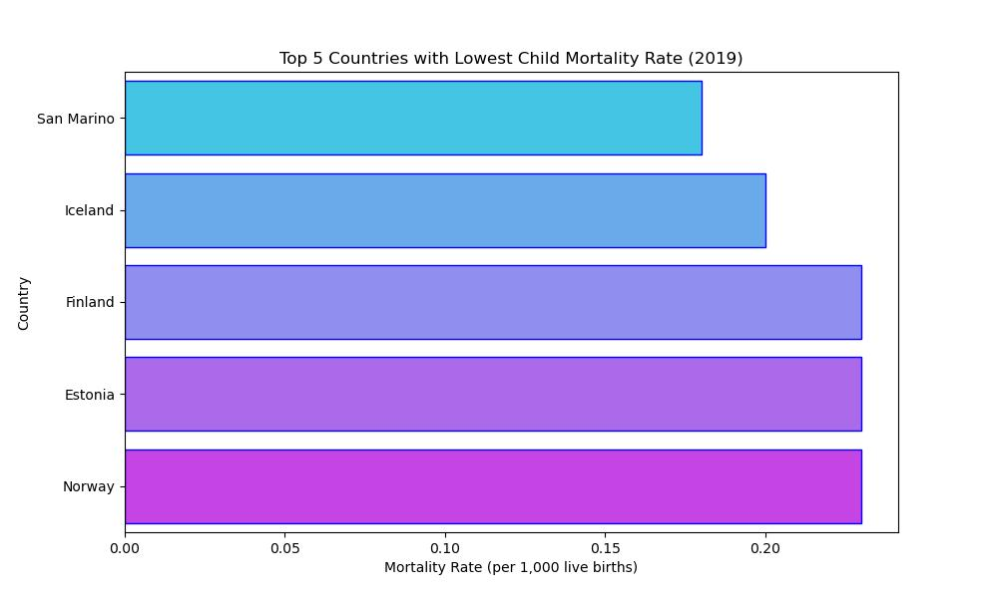
DATA VISUALIZATIONS: Top 5 Countries With Lowest Child Mortality
Top 5 countries with the lowest mortality rates are in Europe

Slide 11
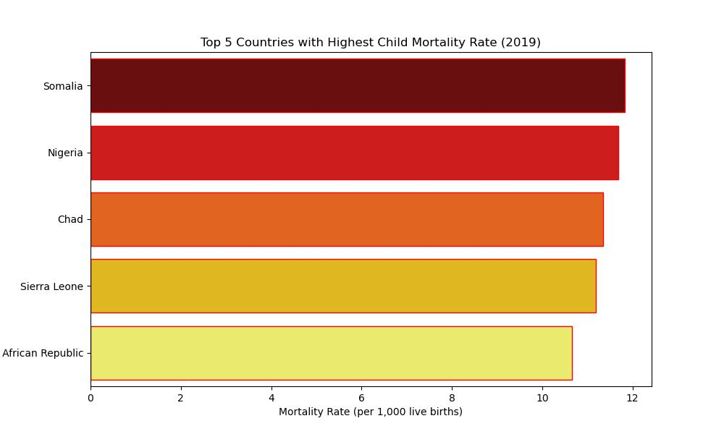
DATA VISUALIZATIONS: Top 5 countries with highest child mortality
Top 5 countries with the highest under 5 mortality rates are from Sub Saharan Africa

Slide 12
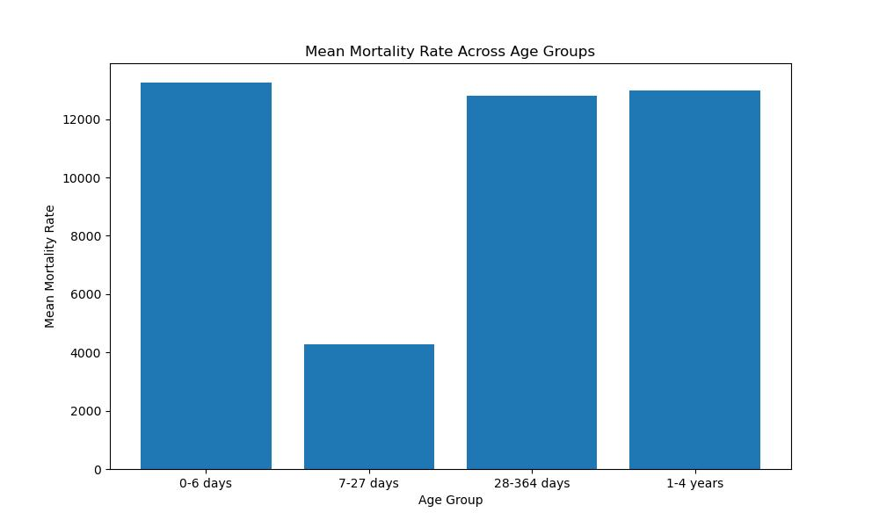
DATA VISUALIZATIONS: Mean Mortality Rates Across Age Groups
The age group 7-27 had the least mean mortality rate of about 4000 while the other groups were at 12000 and above

Slide 13
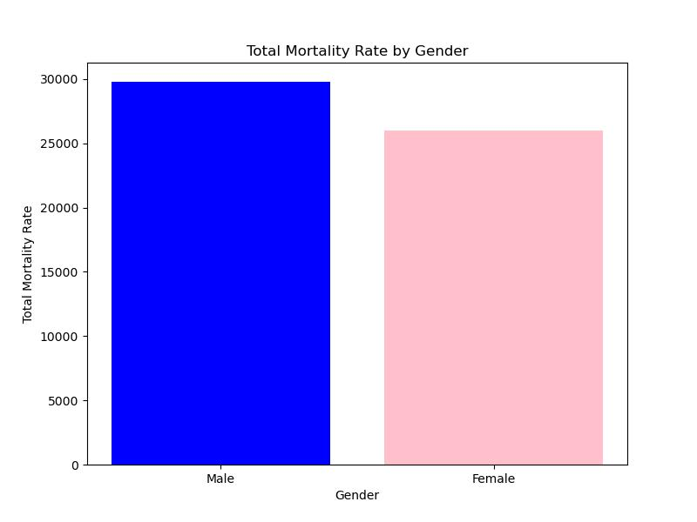
DATA VISUALIZATIONS: Mortality Rate By Gender
Male children under 5 are at a higher risk of mortality than female children the same age

Slide 14
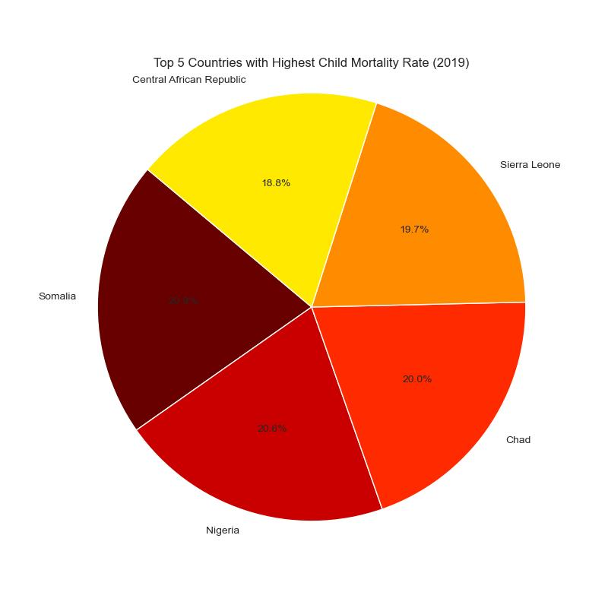
DATA VISUALIZATIONS: Top 5 Countries With Highest Mortality Rate
Countries with current(2019) high mortality rates

Slide 15
DATA ANALYSIS
Cluster Analysis
We used KMeans clustering to create a binary target variable for under-5 mortality risk, distinguishing between high and low risk
Feature engineering
Transformed dataset for analysis by calculating mean mortality rates for disease categories, simplifying columns, and marking highest values
Classification
We evaluated several classification models for predicting under-5 mortality risk, including logistic regression, support vector machines (SVM), naive Bayes, and random forest classifiers
Correlation Analysis
We calculated the correlation matrix to explore the strength and direction of relationships between variables in the dataset.
Time Series Analysis
We converted the 'Year' column to datetime format and set it as the index then plotted the trend of under-5 mortality rates for each country from 1990 to 2020.
Identifying Stationarity
We checked the stationarity of the time series data using the Augmented Dickey-Fuller (ADF) test and visual inspection of ACF and PACF plots.
Seasonal Decomposition:
We applied seasonal decomposition to decompose the time series data into trend, seasonal, and residual components.
Differencing
We applied differencing to make the time series data stationary, where necessary.
Modeling & Forecasting
We used the fitted SARIMA models to forecast future values of the under-5 mortality rate for each country.

Slide 16
MODEL RESULTS
Several classification models were evaluated based on their training and test accuracies.
The Naive Bayes model was chosen as the best-performing model due to its high but not perfect accuracy.
The model had a training accuracy of 94.3% and a test accuracy of 91.5%.

Slide 17
FINDINGS & CONCLUSION
Regional Distribution
Highest under-5 mortality rates are concentrated in Sub-Saharan Africa and Southeast Asia, while Australia, North America, and Europe have the lowest rates.
Country Specifics
Top 5 countries with the highest rates are from Sub-Saharan Africa (West and Central Africa), while the lowest rates are in Europe (Nordic and Baltic countries).
Leading Causes
Lower respiratory infections, diarrheal diseases, preterm births, neonatal encephalopathy, trauma, and congenital birth defects are the main causes.
Gender Disparity
Male children under 5 are at a higher risk than females.
Trend Analysis
Mortality rates have generally reduced since 1990, except for early neonatal mortality which remains high as of 2019.
Critical Year
1994 saw the highest under-5 mortality, with Rwanda recording the highest rate.

Slide 18
INSIGHTS AND RECOMMENDATIONS
Governmental Commitment and Leadership
Prioritize children's health with strong leadership and commitment
Community-Based Health Initiatives
Engage communities for mother and child health and healthcare access.
Health Insurance Coverage
Ensure comprehensive coverage, especially for vulnerable populations
Investments in Healthcare Infrastructure
Allocate resources for improved access to quality services
Emphasis on Preventative Healthcare
Focus on immunizations, nutrition, and family planning
Partnerships and Collaborations
Collaborate with international organizations and stakeholders for better healthcare delivery

Slide 19
DEPLOYMENT
We deployed model to predict mortality rate risk

Slide 20
NEXT STEPS
Gather additional data on factors influencing under-5 mortality, i.e parents' demographic details, country and regional health expenditure, income levels, health-seeking behaviors, and medical insurance statistics.
Apply World Health Organization thresholds to categorize different populations based on their risk levels, providing a standardized approach for risk assessment across various regions and countries

Slide 21
Q&A

Slide 22
THANK YOU

